Slide 1

Members Only Area
Guide Book
Florida Head Start Association
An illustrated guide to getting the most out of
our interactive and self-service website
Notes:
At some point in a world long long ago the dream of AMS was that it could help you realize this imagined world….. But it isn’t working

Slide 2


Membership Has its Privileges
Our website is powered by MemberClicks, the association industry’s most powerful Association Management Software systems.
Our website offers many self-service and exclusive benefits that only members and/or their employees can take advantage of
To ensure only Members receive these benefits, these areas of our site require a valid log in
The pages in this guide will teach you how to log in and update your information, as well as take advantage of as many benefits as possible
The more you update and personalize your membership, the more value you will receive from us

Slide 3

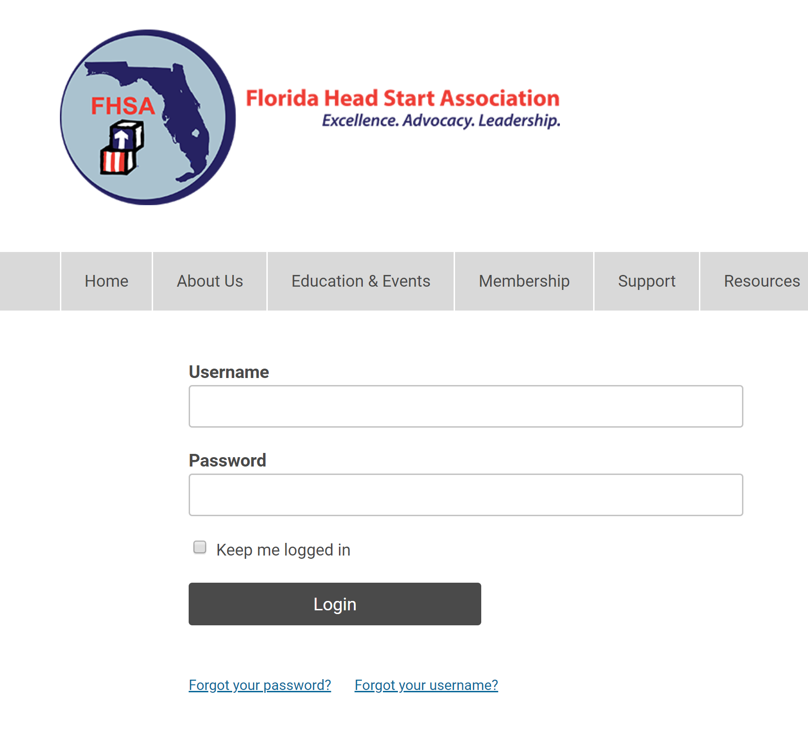
Take Control of Your Membership
Once you have a Username and Password, you can use it to access any Members-only or restricted items, like event discounts, members events, member directory and the social community features.
If you have forgotten your password, no worries! Click ‘forgot your password’ or ‘forgot username’ and enter the email address associated with your profile. You will then be emailed a link to reset your password.
(HINT: you might want to try your email address as your username.)
Note: To receive the link via email, the email address you enter must be the email address in your membership profile.

Slide 4
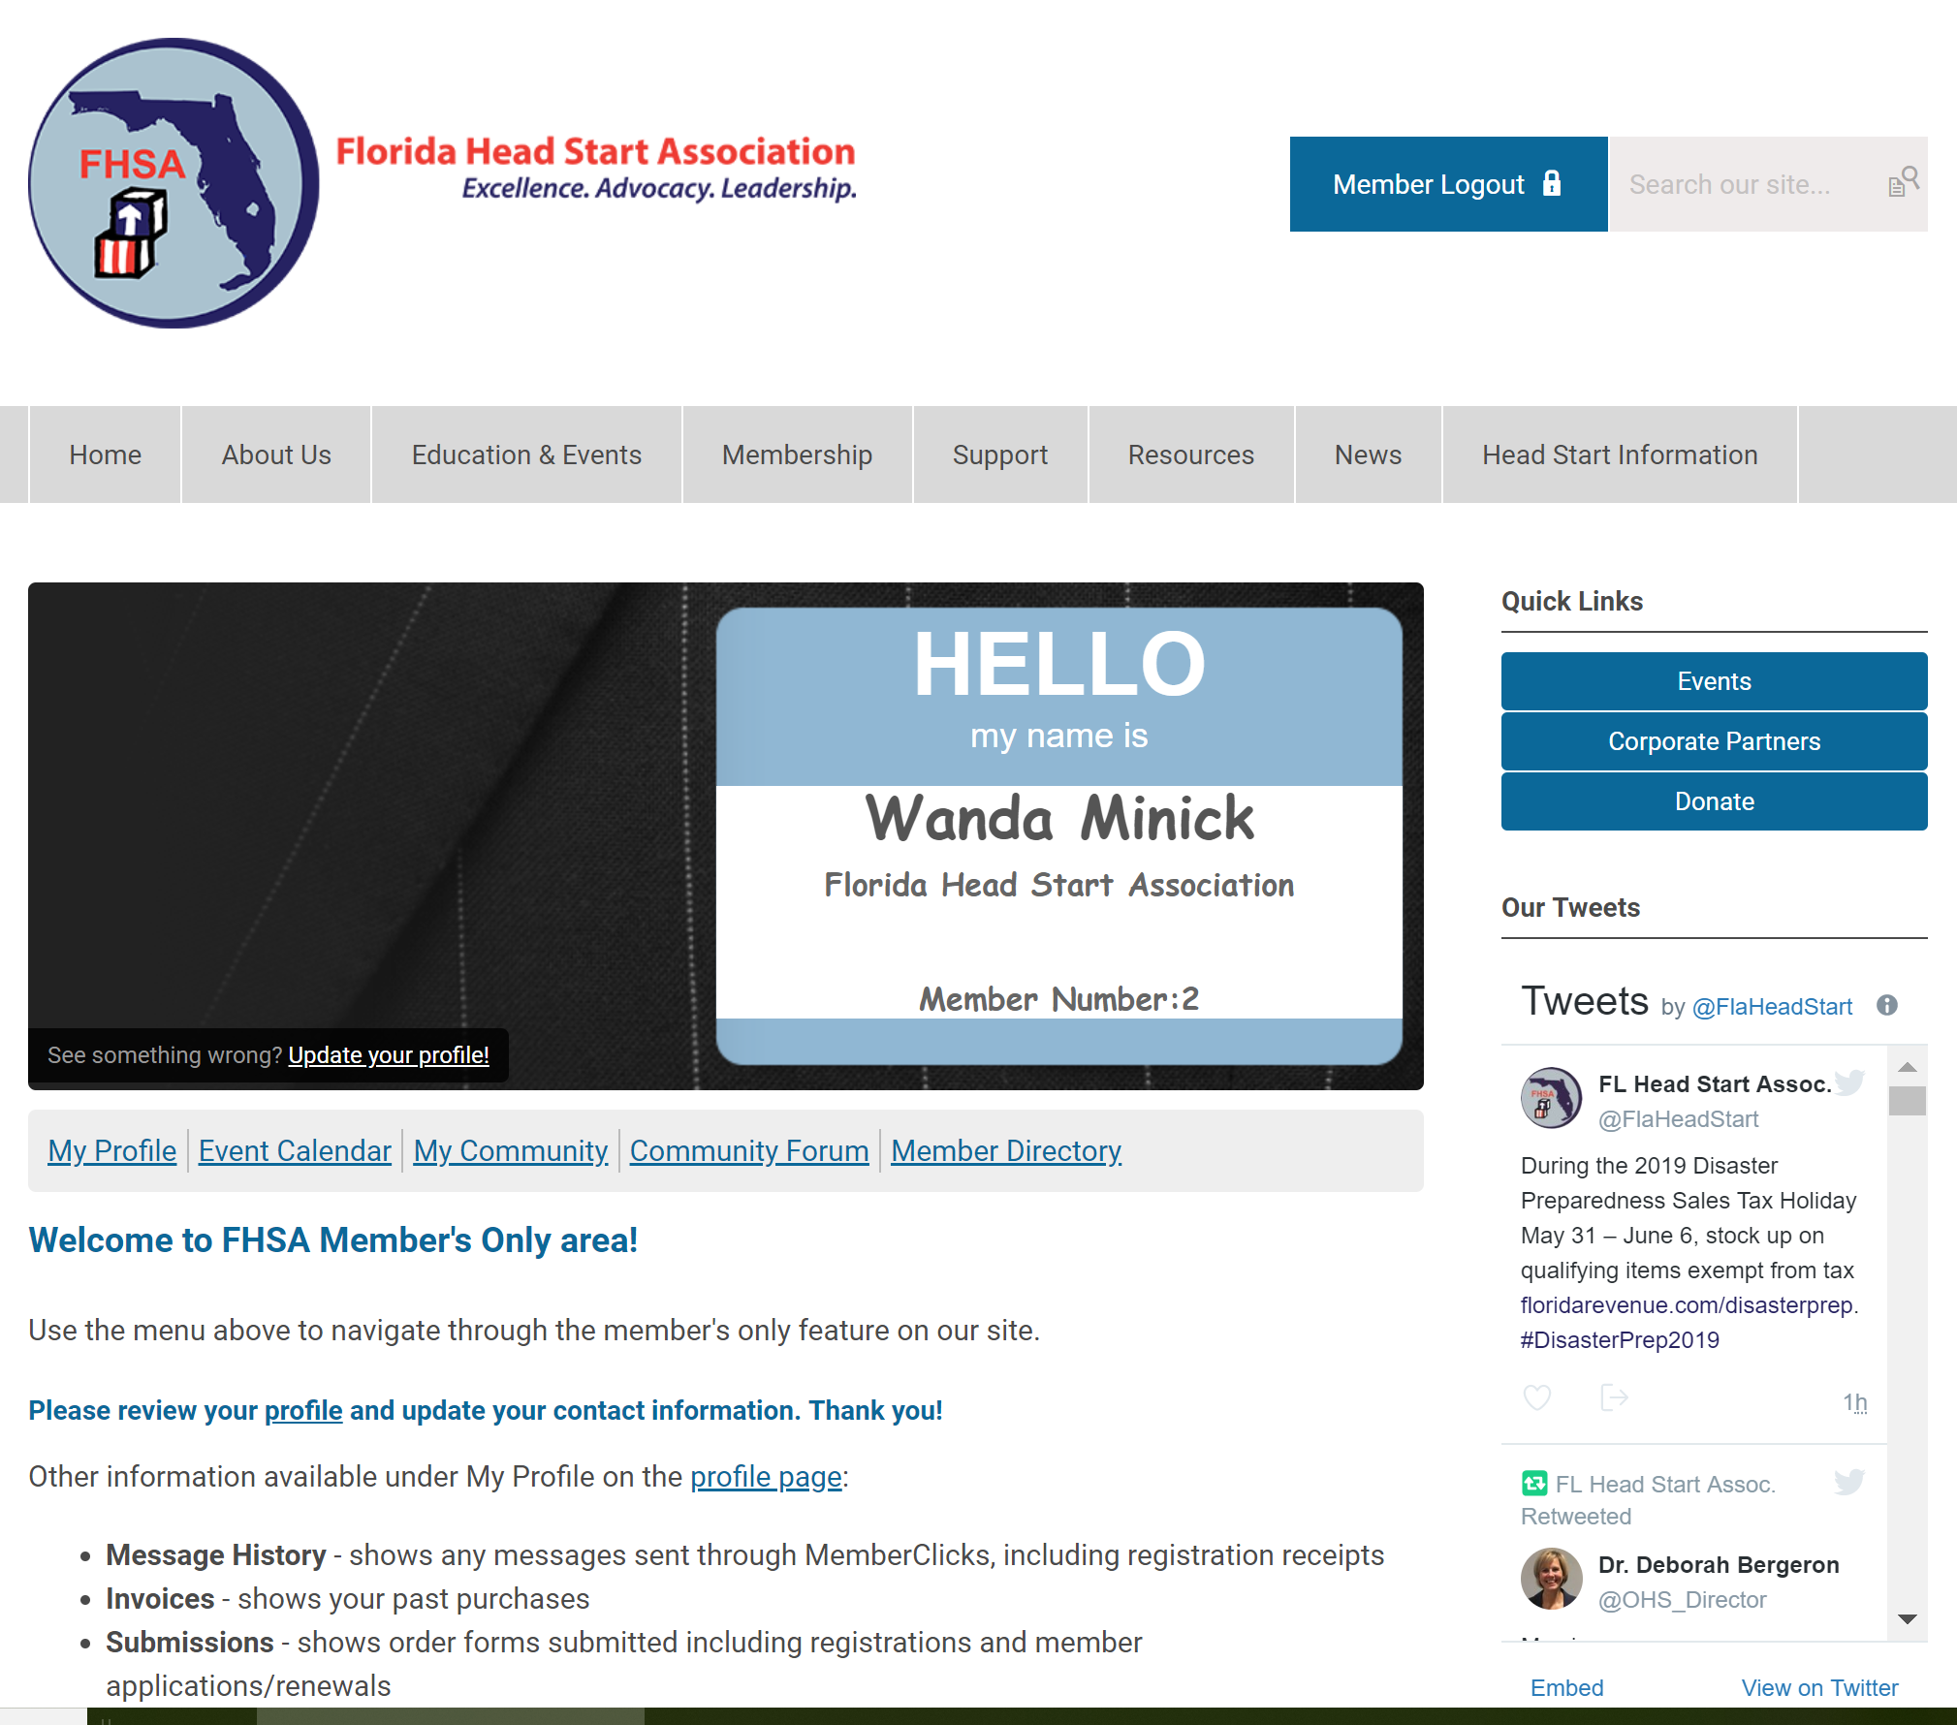
What Can I Do Here?
View your profile
View/ Pay Invoices
Access the Member Directory
View the Event Calendar
Access to Social Community Features
View any members only content on this website
Interact and connect with other members

Slide 5
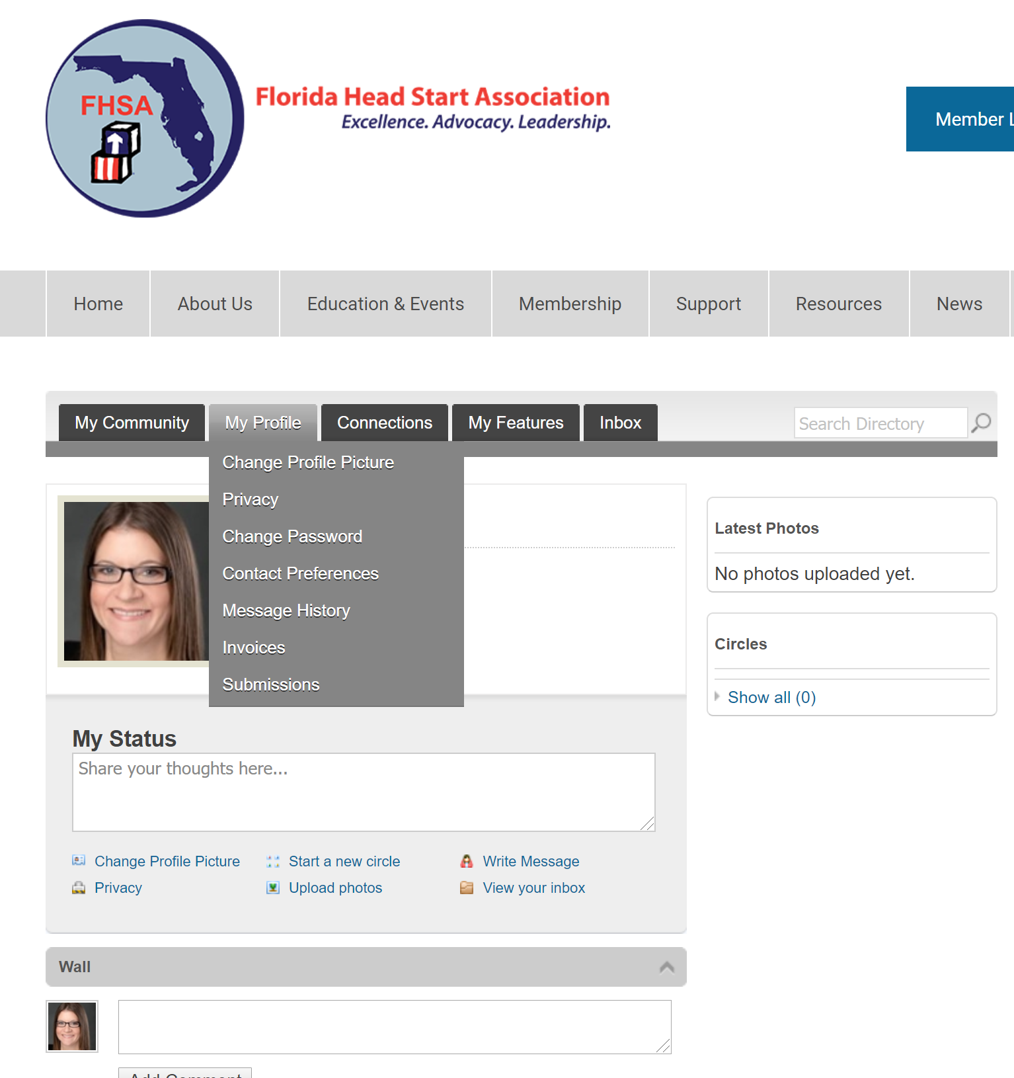
If you hover over the words ‘My Profile’, you can make additional changes to your profile.
In this area you can :
Change your profile picture that shows on the Member Directory
Edit your privacy settings
Change your password
Manage how we contact you
View past emails we have sent to you
View a list of all your invoices
View all forms that you have submitted

Slide 6
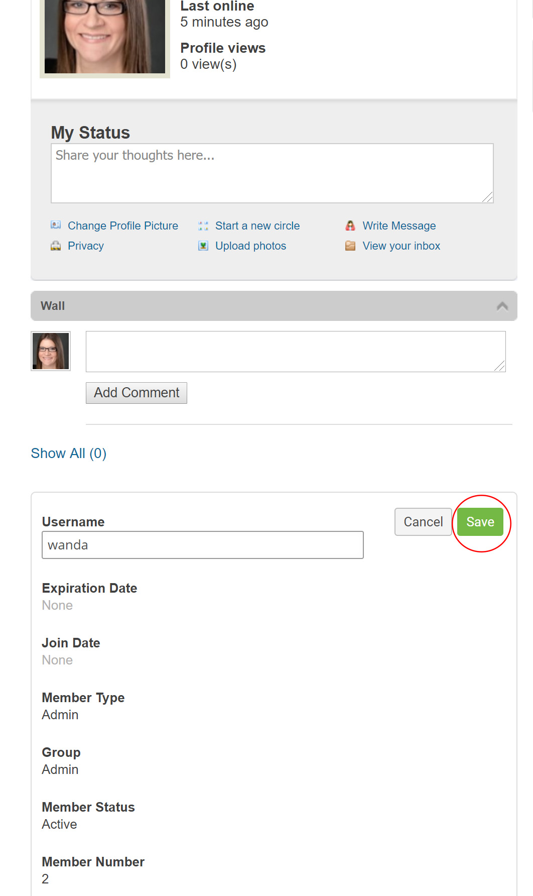
My Profile
These fields show you what information we have now. Please fill in any blanks so that we can know you as well as possible.
Information here can be used on your Directory listings or for communications we send out.
Make sure to click Save at the end of the process.

Slide 7
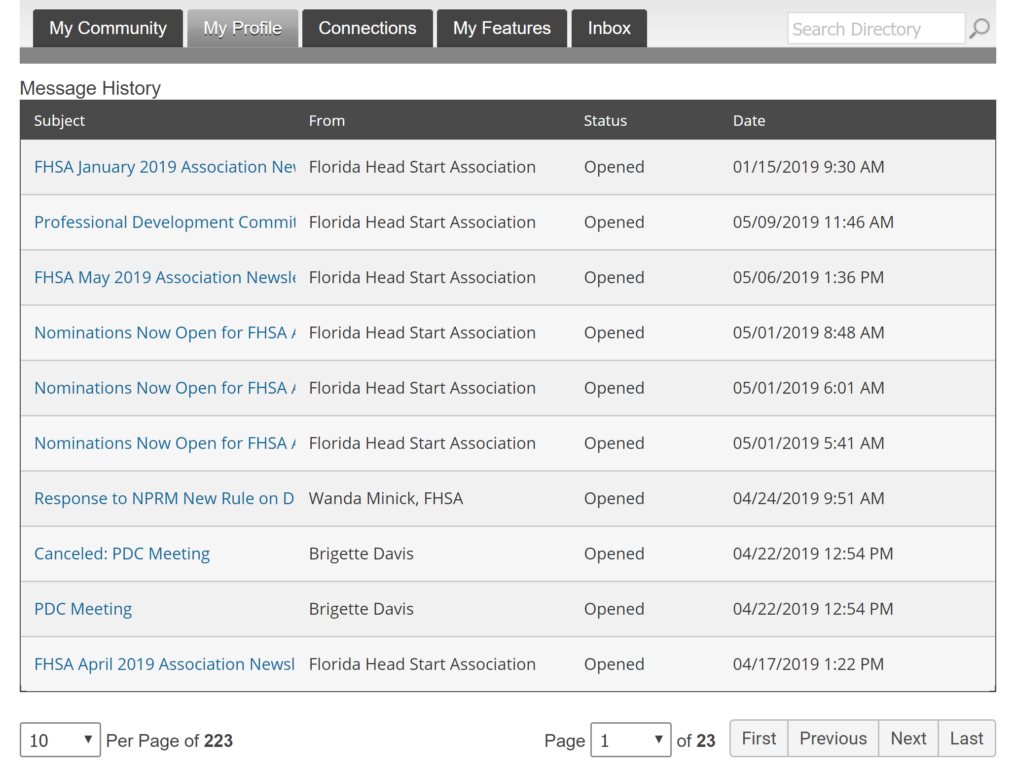
Message History
The Message History area will show you all of the emails the organization has sent to your personal inbox. If you ever delete an email, there is a full record kept in this area of your profile. Simply click on the subject line to open the body of the email.
Having a hard time receiving emails? White List our email address.
Click here to see how.

Slide 8
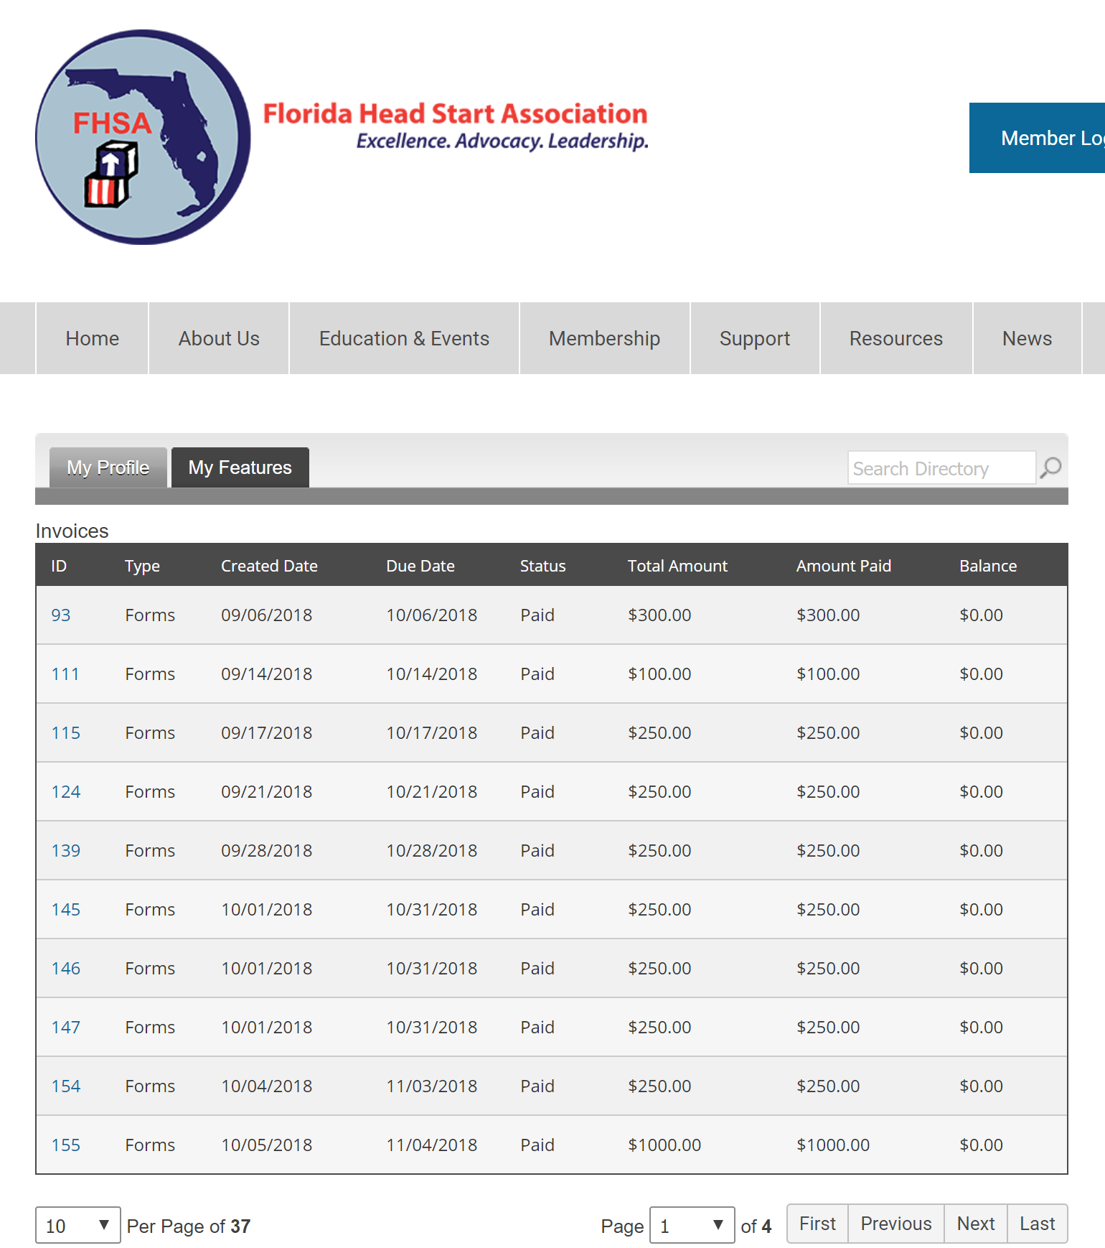
View your Invoices
Under ‘My Profile’ you have the ability to display your invoices.
This area will show you past paid invoices and open invoices that you are able to pay.
To open any of these invoices, simply click on the Invoice ID to view the invoice.

Slide 9
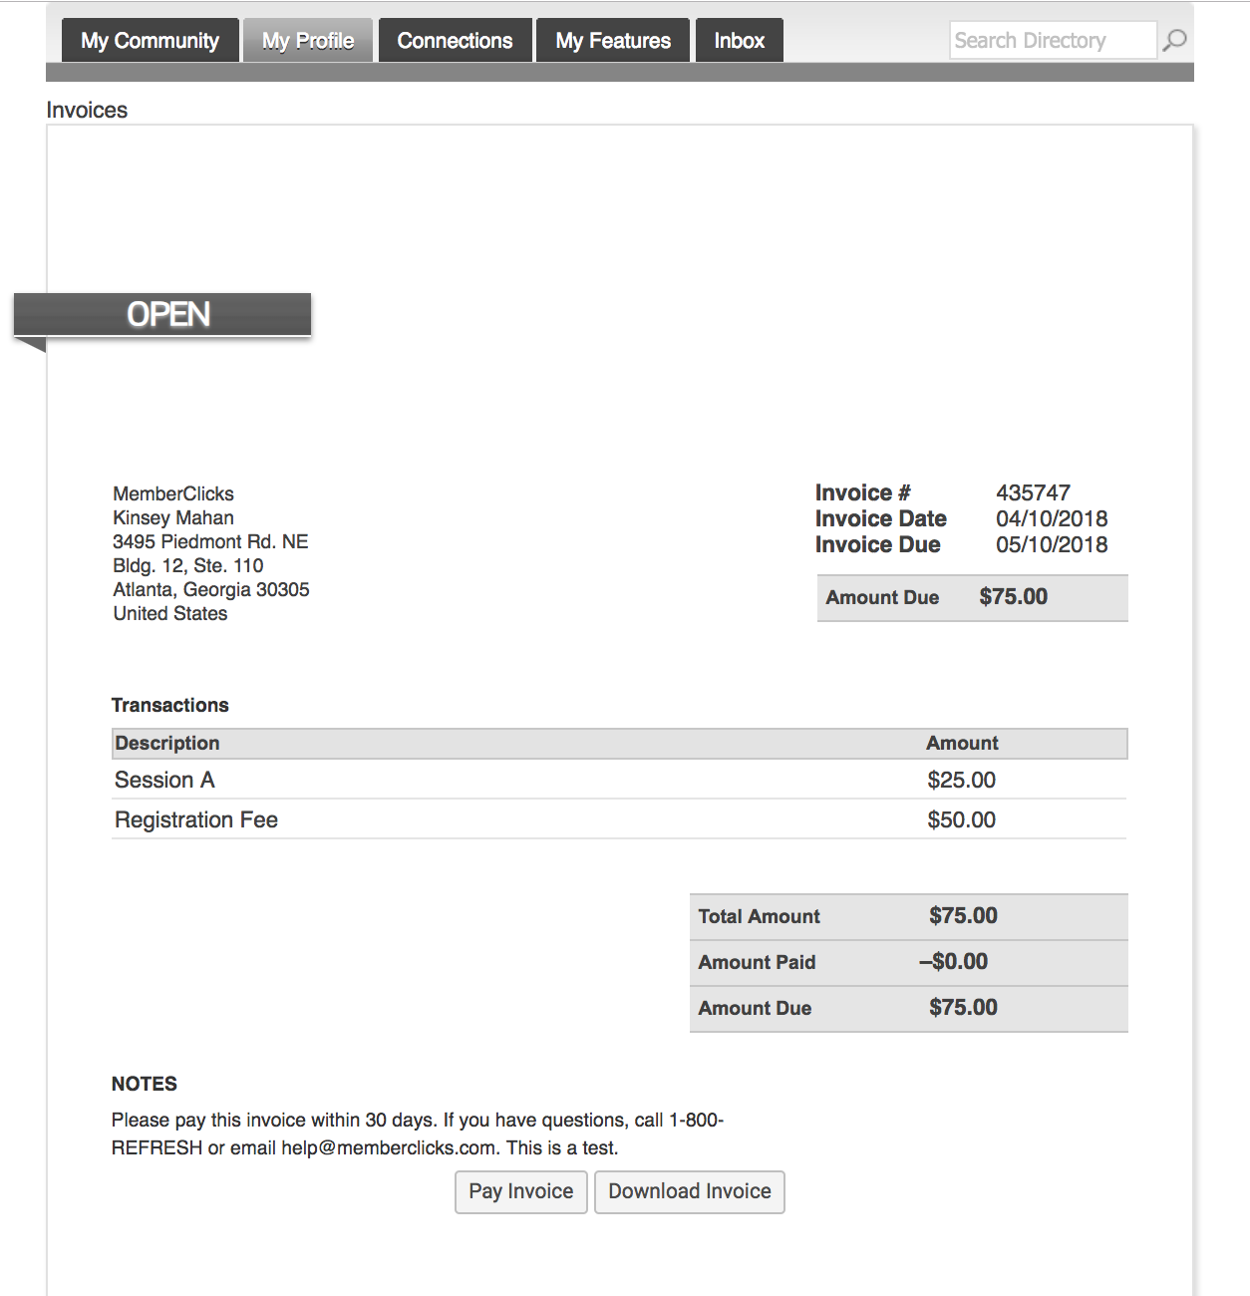
Pay Your Invoices
Once you have clicked on the Invoice ID
You have the option to pay an open invoice or download an invoice.
Paying an Invoice: Paying an invoice couldn’t be easier. Simply click on the button at the bottom ‘Pay Now. Our payment area will come up for you to enter your card and billing information.

Slide 10
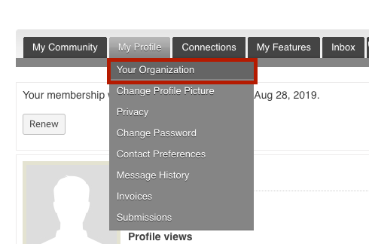
Organization Structure.
Key Contacts changes to Organizational Profiles
If you are the Key Contact (aka: admin) to an Organization, you are able to make changes to the organization profile through your individual profile.
To update your Organization's’ profile, hover your mouse over ‘My Profile’ and click on ‘Your Organization’.

Slide 11
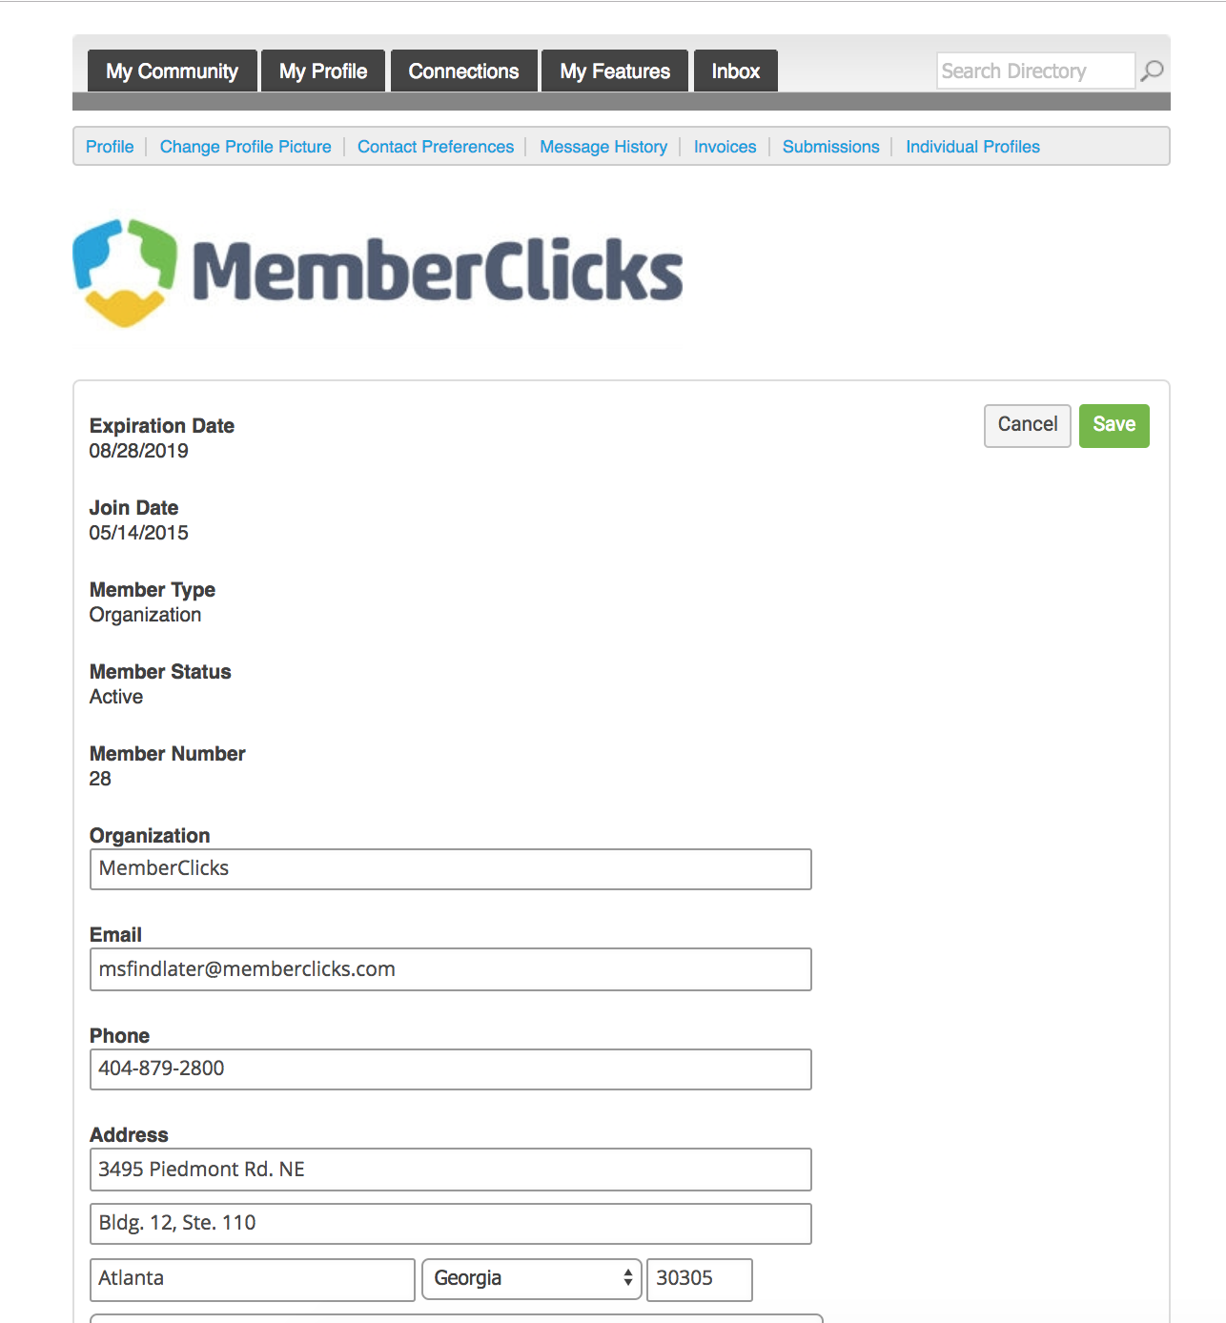
Key Contacts
Information here can be used on your Directory listings or for communications we send.
These fields show you what information we have now. Please fill in any blanks.
Note: the email field is the email address we will send your renewal notice to.
Make sure to click Save at the end of the process

Slide 12
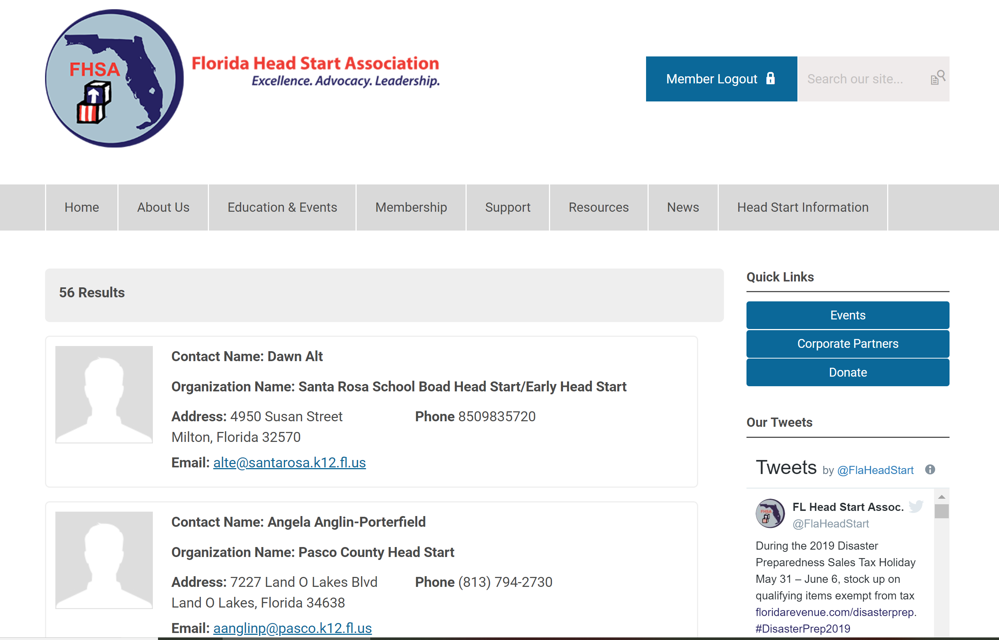
Member Directory
Our Member Directory can be valuable in connecting you with other members. To update what displays for your profile in the directory listing, please edit your profile that were provided in the earlier steps.

Slide 13

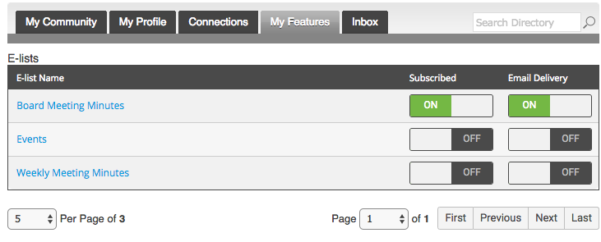

E-List
Your membership includes access to our exclusive e-list (AKA, listserv).
This tool allows you to distribute messages to all of the members subscribing to the list with a simple email to the list address.
Communicate with the membership through a single email.
Manage your subscription and preferences through your member profile.
To get started:
Log into your profile.
In the My Features tab, click E-Lists.
Make sure you are subscribed to the list.
Make note of the list address. (Add is as a contact in your personal inbox)
Click Edit to control your preferences.
Click the list name to see and search previous posts.
To start participating:
(From your profile) Click ‘Post a New Message’
(From your personal Email Inbox) Send an email to the list address using the email
Address that is listed in your profile.

Slide 14
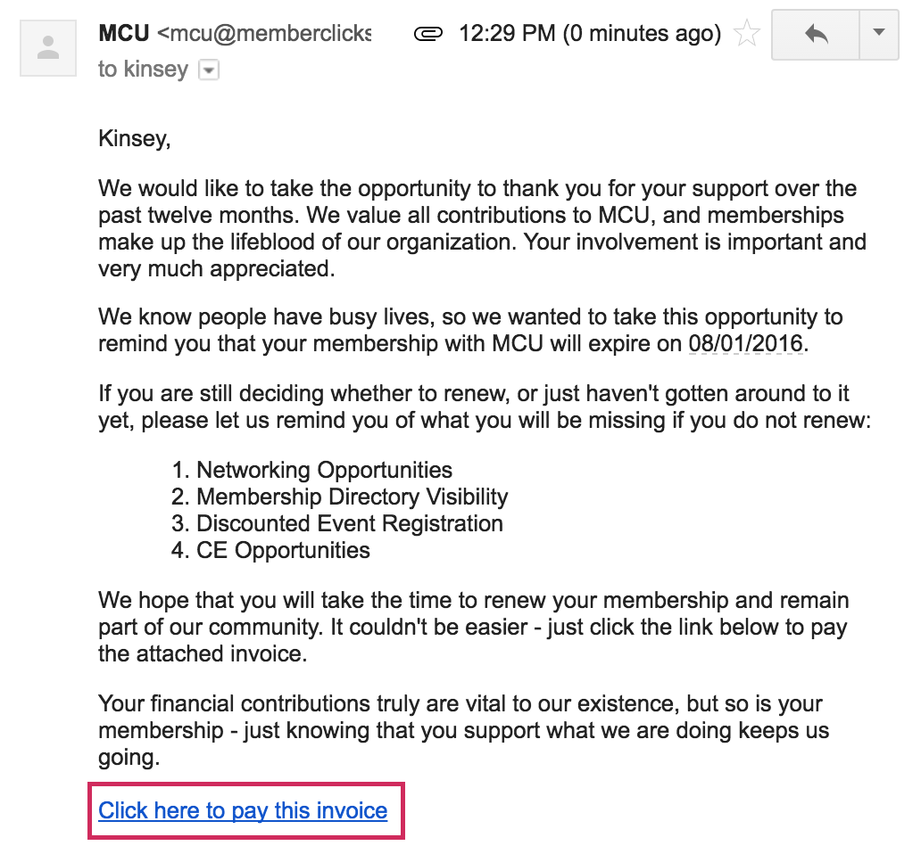
How to Renew Your Membership
Here's an example of a renewal email that will be sent directly to your personal email inbox.
A member can renew their own membership in one of three ways:
By paying the auto-generated Renewal invoice tied to their renewal notification
By logging in and submitting a Renewal Form
By logging in and using the Renew option from the My Profile page

Slide 15
Renew from your personal inbox
Here's an example of a renewal email that will be sent directly to your personal email inbox.
Simply click "Click here to pay this invoice” to be taken to your invoice to pay online or download to mail in payment.

Slide 16
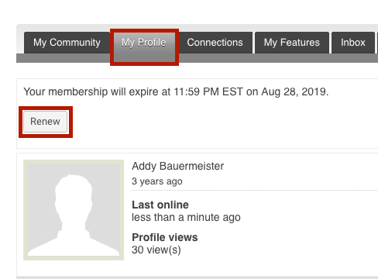
Renew From Your Profile
Log in
Click ‘Renew’
Navigate to ‘My profile’

Slide 17
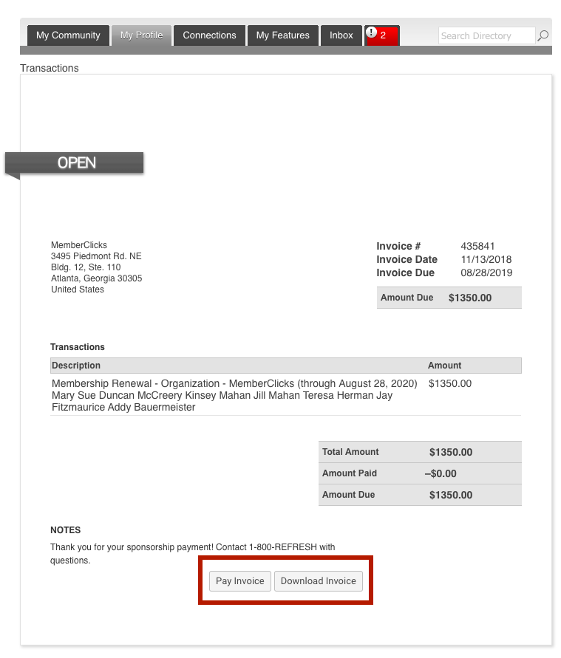
Pay Your Renewal Invoice
Once you have clicked submit. You will be taken to your renewal invoice to pay.
Paying an Invoice: Paying an invoice couldn’t be easier. Simply click on the button at the bottom ‘Pay Now. Our payment area will come up for you to enter your card and billing information.

Slide 18
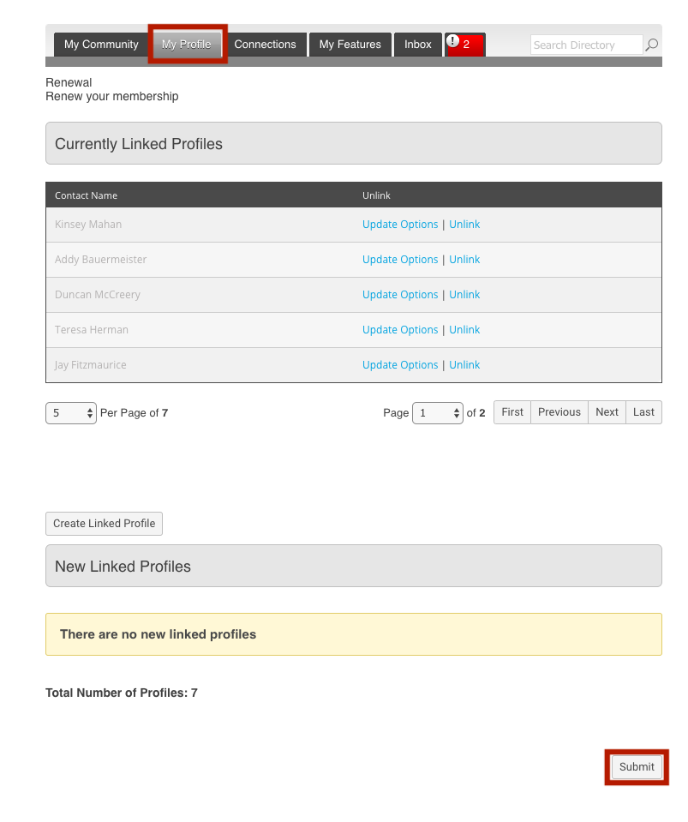
Key Contacts
Key contacts can pay dues on behalf of the organization
Log in to your profile> click ‘Renew’
The will take you to a page to review, add, and unlinked any current linked profiles.
Once you are finished reviewing/ making changes to this area, click ‘Submit’ at the bottom
You will now be taken to your renewal invoice to pay or download.

Slide 19
Questions?
If you experience any issues please contact the FHSA office at (850) 694-6477 anytime Monday – Friday 8:00 AM – 5:00 PM
You can also email Info@FLHeadStart.org

